Slide 1
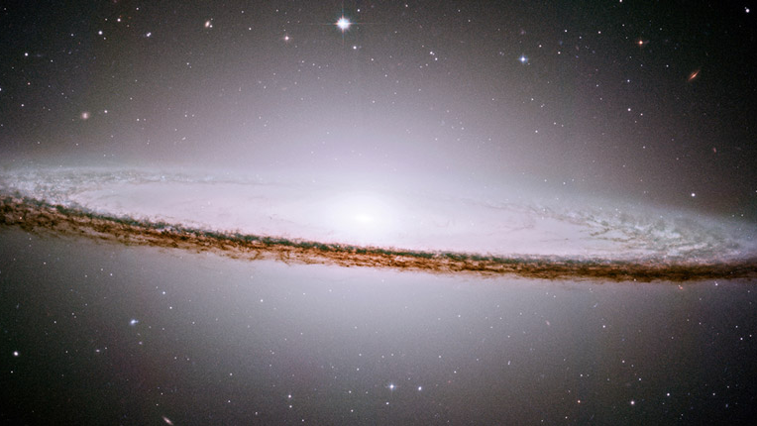
Nebula Wars
Created by:
Thomas Stewart
Metin Erman
Shane Barry
Michael Quinn
Diane Gregory

Slide 2

Programs Used
Unity, is a cross-platform game engine developed by Unity Technologies, which is primarily used to develop video game and simulators for computers, consoles and mobile devices. (Version 2017.1.0f3)
Source Tree, created by Atlassin, is a Git desktop client for developers on Mac or Windows

Slide 3
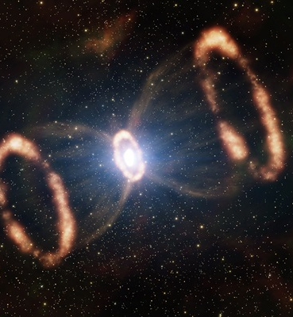
Nebula Wars
Nebula Wars Is a 2D game, where you as the player fly a fighter through space and try to clear all of the enemies and debris.
There are multiple levels to the game.
Games and replays can be saved so that you can come back later and watch a replay or resume a game.
Scores are sent to the games website where you can find the best scores on the leader board.
You can play Nebula Wars in single player or multi-player.

Slide 4
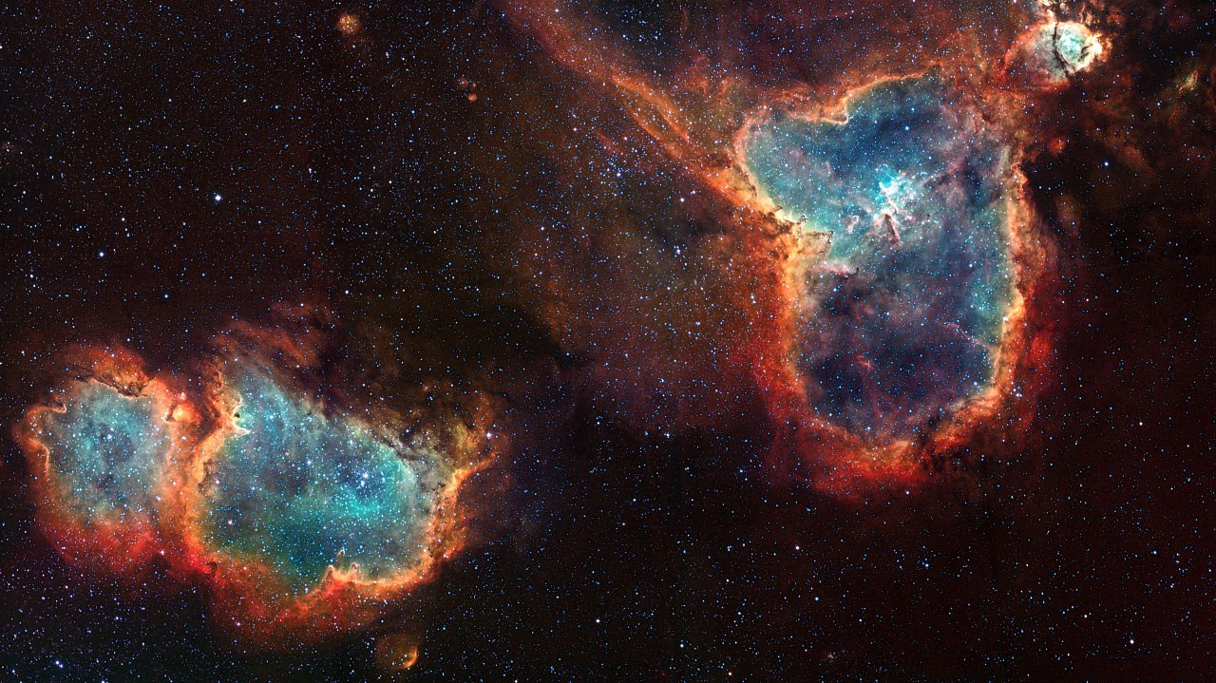
Website: http://nebulawars.heliohost.org
Leader boards
About the game
About the developers
Contact us

Slide 5
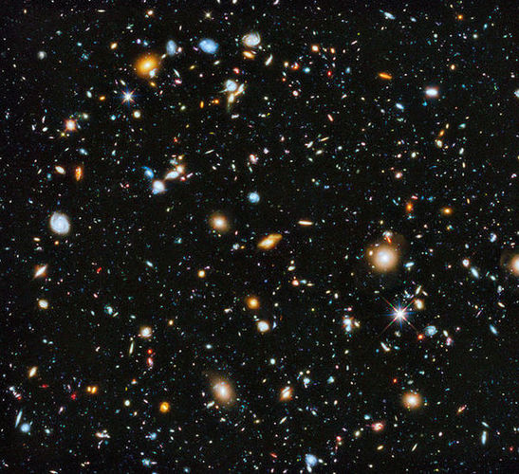
Code
All the code necessary to run the game is on our GitHub repository. https://github.com/maerman/CSCI466Project.

